Slide 1




Virtual Tour Consultant
19 May 2021
Notes:
Intro team members

Slide 2
Approach
Business
User/Human
Business Problem
User Research
Empathy Map
As-is Scenario
Intents
To-be Scenario
World
Machine
Data and Policy
Understanding
Reasoning
Knowledge
Expression
User/Human
Machine
Business
User Reaction
Learning
Outcome

Slide 3
Business Problem and Project Objectives

Slide 4
Business Problem and Project Objectives
Background
Background
Background
Business problem
Background
Project objectives
Singtour is a tour agency with only a physical shop front
Singtour had traditionally relied on older customers who “walk in” to their store, but sales has been dropping over the years
Singtour wants to increase their customer base to include more young working professionals while keeping manpower cost low
How can SingTour increase sales by enabling busy working professionals to easily find and book a tour package online?
Build a business website for Singtour
Build a chatbot that can answer queries and facilitate tour booking 24/7

Slide 5
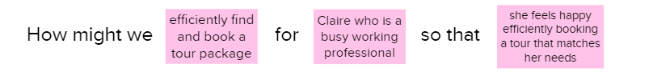
HMW Statement

Slide 6
User Research

Slide 7
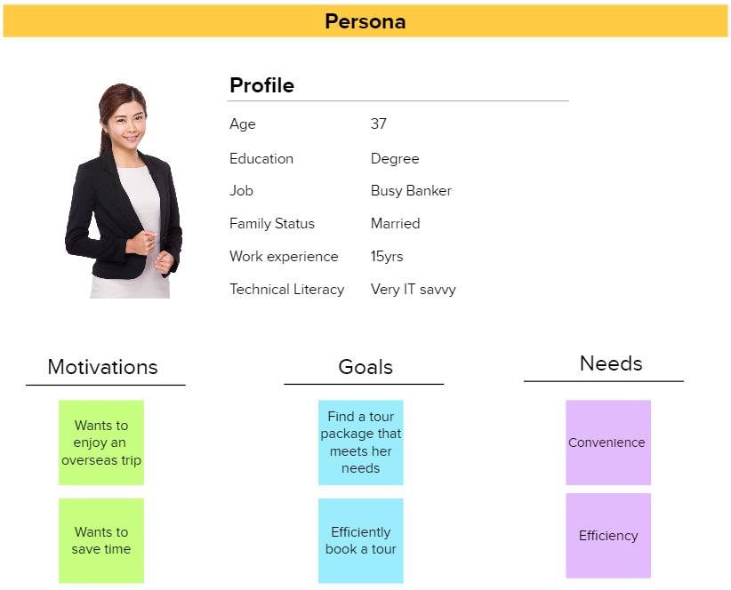

Slide 8

Sample interview questions
What made you consider to book an overseas tour?
How did you go about exploring which tour agency to use?
In your experience, how well does the current tour agencies address your needs?
How did you go about exploring which tour package to go for?
What were you feeling when comparing between different tour packages?
How did you make a decision which tour package to choose?
How do you think tour agencies can improve in terms of customer experience?

Slide 9
Empathy Map

Slide 10
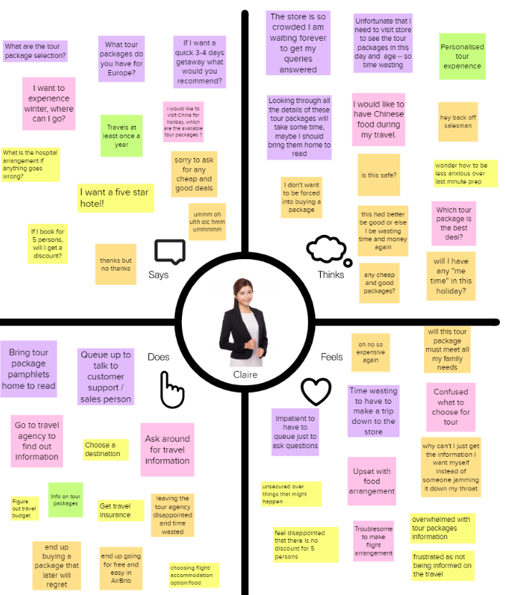
Empathy Map

Slide 11
As-is Scenario and Pain Points

Slide 12
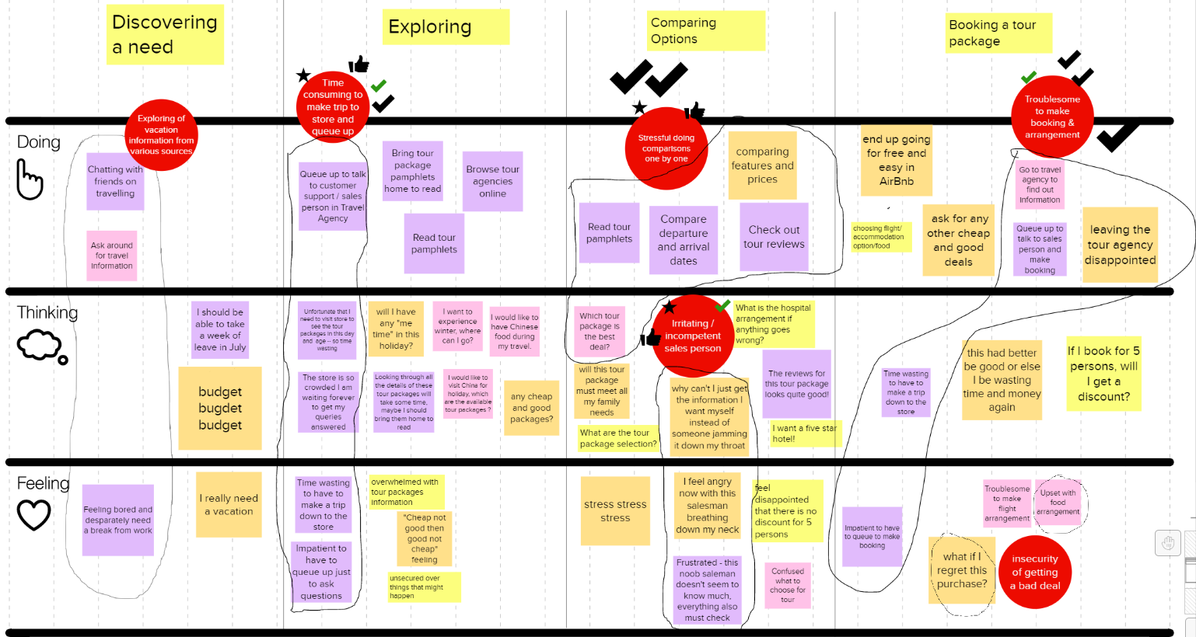
As-is Scenario and Pain points

Slide 13
Reframing the HMW Statement

Slide 14
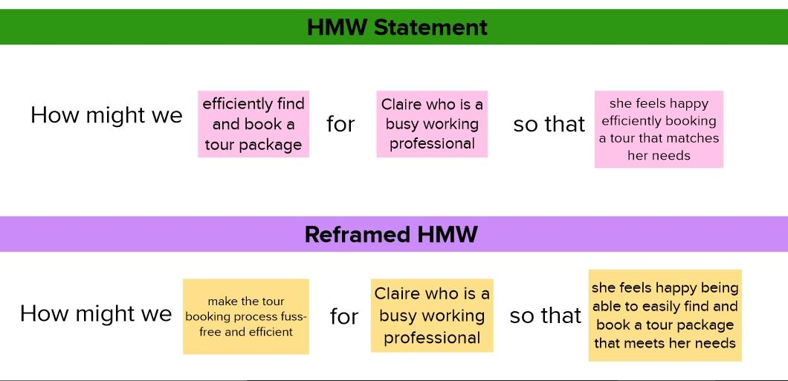

Slide 15
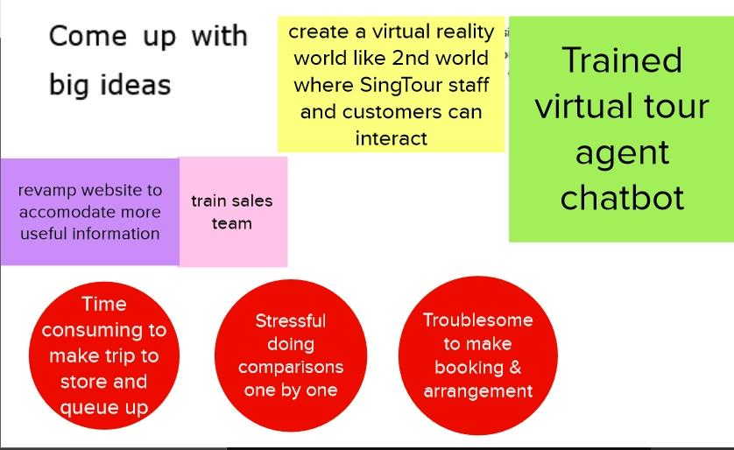
Notes:
No brainer - Chatbot (with a website)
We wanted a virtual universe (like 2nd life) where users and staff can interact however we parked this aside in favour of Chatbot
After going though many iterations of the loop we still ended up with a chatbot (not because CEO wants it)

Slide 16
1. Intent

Slide 17
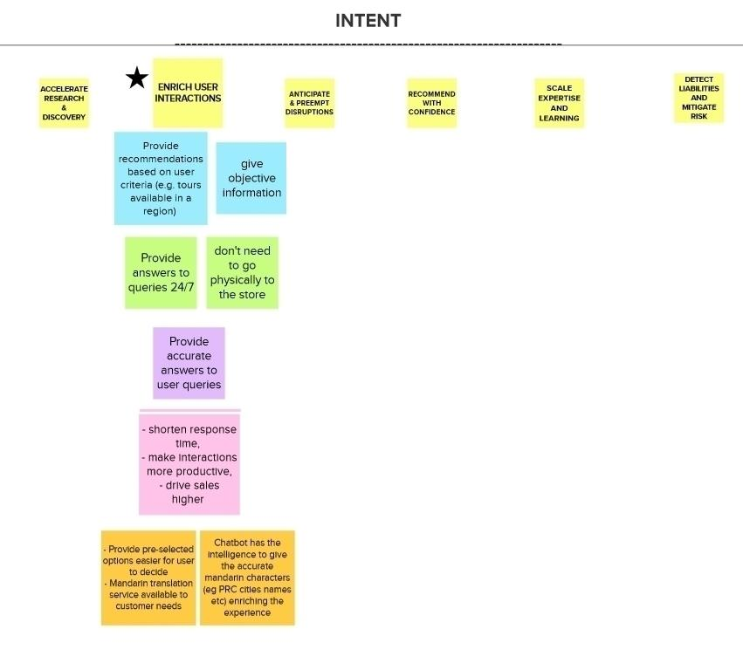
AI
Notes:
Kana: Does Mandarin translation gel with the persona?
Priority is to to solve business problem, address the persona, and have no loop holes

Slide 18
To-be Scenario
Notes:
Clarify what the MVP will focus on for the purpose of this project (MVP is the live demo) versus this to-be scenario

Slide 19
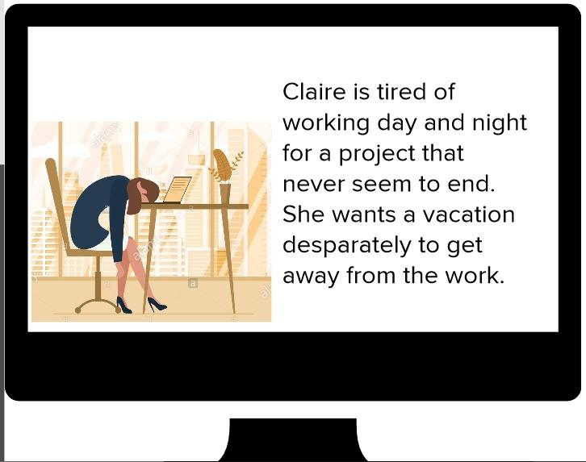
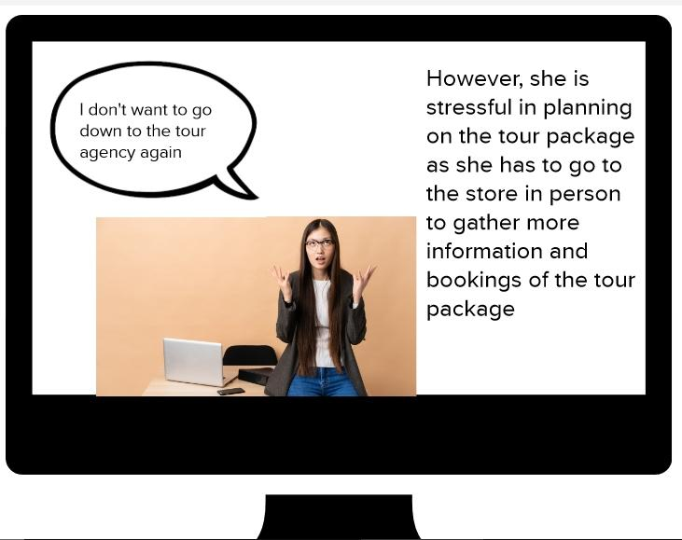
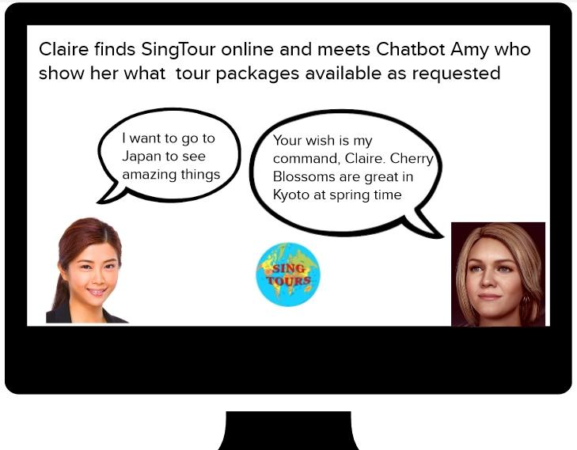
To Be Scenario - Enriching User Interaction AI intent 1
Notes:
Shows ideal scenario - Chatbot gives accurate recommendations and extras based on user query (constrast to MVP)
Also, recommendations for user to go to Japan to see Cherry Blossoms and result in booking at the end.

Slide 20
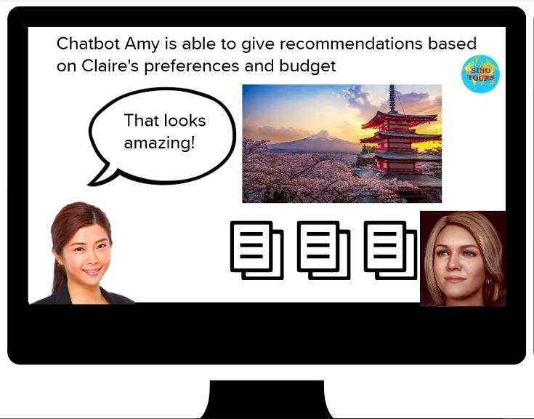
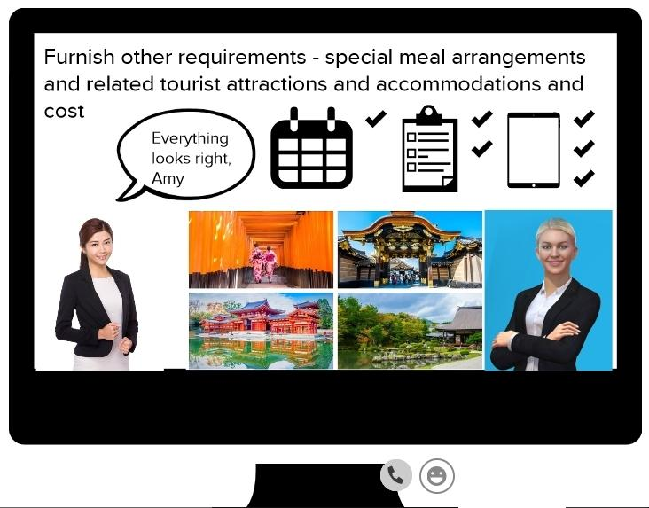
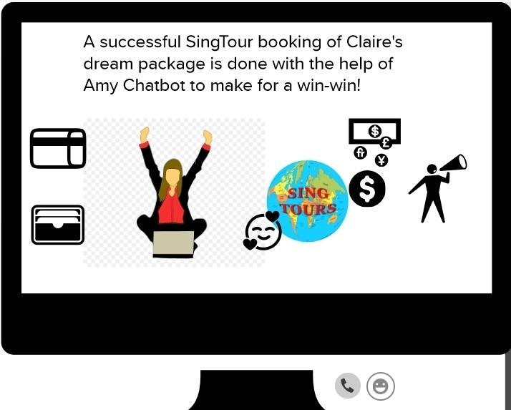
To Be Scenario - Enriching User Interaction AI intent 2
Notes:
our MVP (has no chatbot name) while Amy is the name of chatbot given here
State clealy what our MVP will address and why we were not able to build a chatbot that shows the ideal scenario.
I will hand off to the Lee Ting the next presenter for the data portion for our chatbot

Slide 21
2. Data and Policy

Slide 22
Data
 | Public | Private | User
Have | Dataset from Github | Company internal information | Customer personal information
Want/Need | Customer Dialog | Confirmed order details | User Preferences
Nice to have | Weather condition | Disclaimer statement | Spending patterns, Credit rating
Notes:
Redesign slide - just summarize points in mural

Slide 23
Policy
comply with the laws governing the data protection
ensure that we do not disclose the data we collected from user to any other external parties

Slide 24
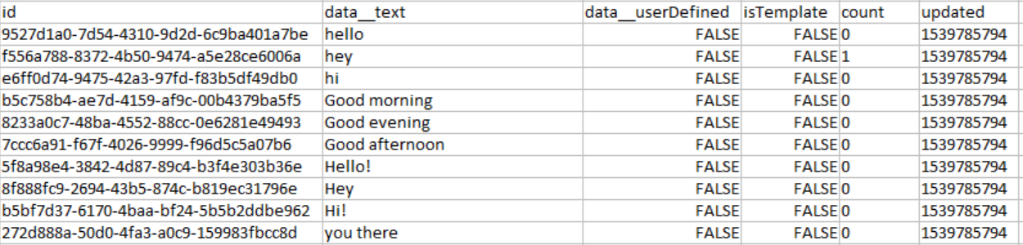
Data Preparation & Transformation
dataset from Github
related to travel industry and helps to achieve our intent of enriching interaction.
converted the files from json to csv
consists of 8550 rows 6 columns
First 10 rows of dataset
Notes:
Re : Why we choose it? It is the dataset we managed to find that is related to our travel business to solve the problem.

Slide 25
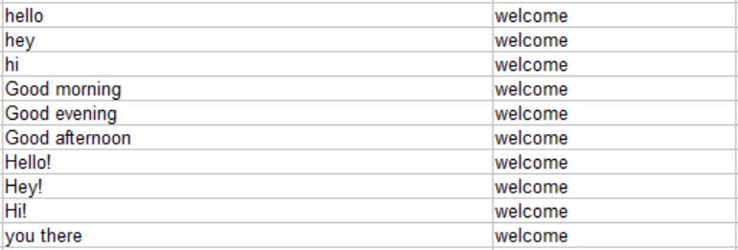
Data Preparation & Transformation
Irrelevant (ie.the blank, meaningless and duplicated)
rows and columns are removed
Intent names are imputed
After the cleaning process, dataset comprises of
1351 rows 2 columns
All are unstructured data
First 10 rows of dataset after completion

Slide 26
3. Understanding

Slide 27
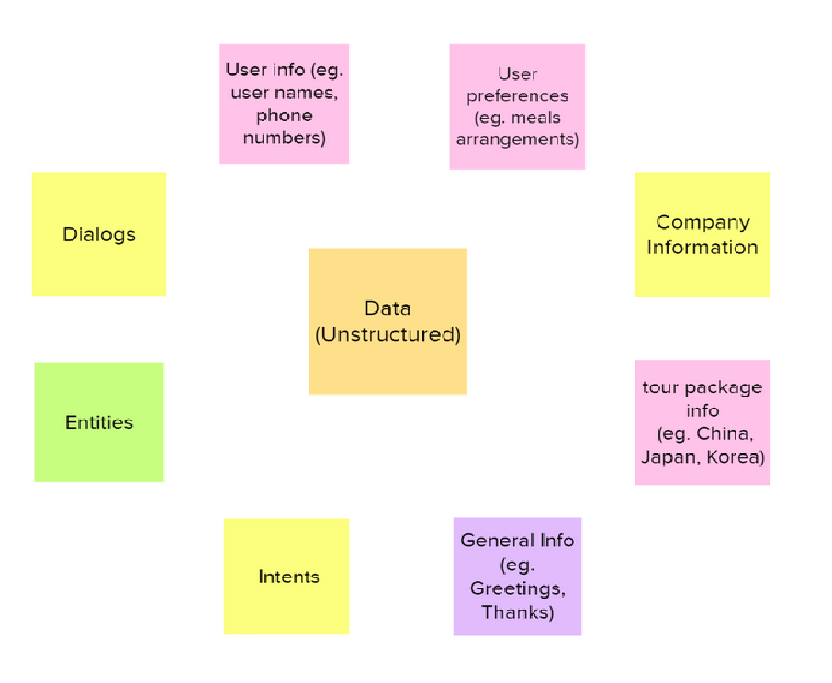
Understanding

Slide 28
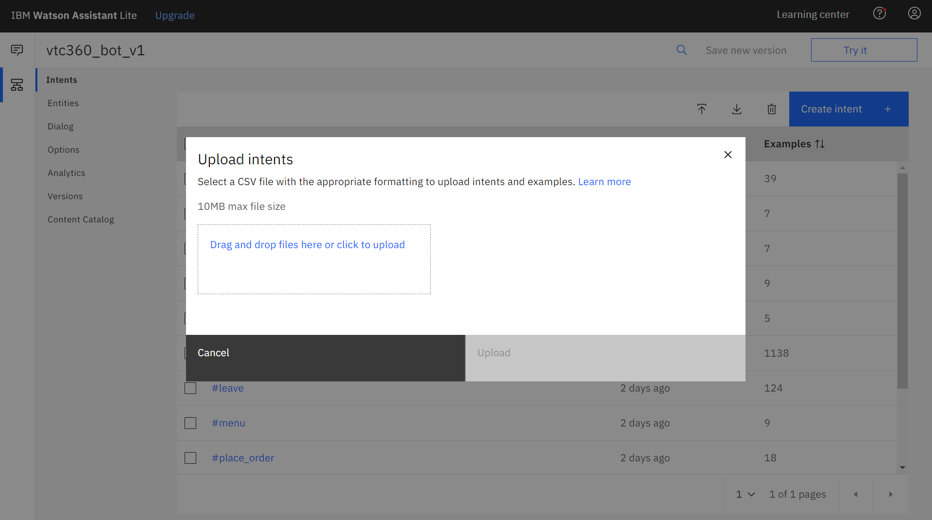
Intents upload
Notes:
What is fed into the machine is shown in the intents (the next slide).
The relevant data is used for building the MVP.

Slide 29
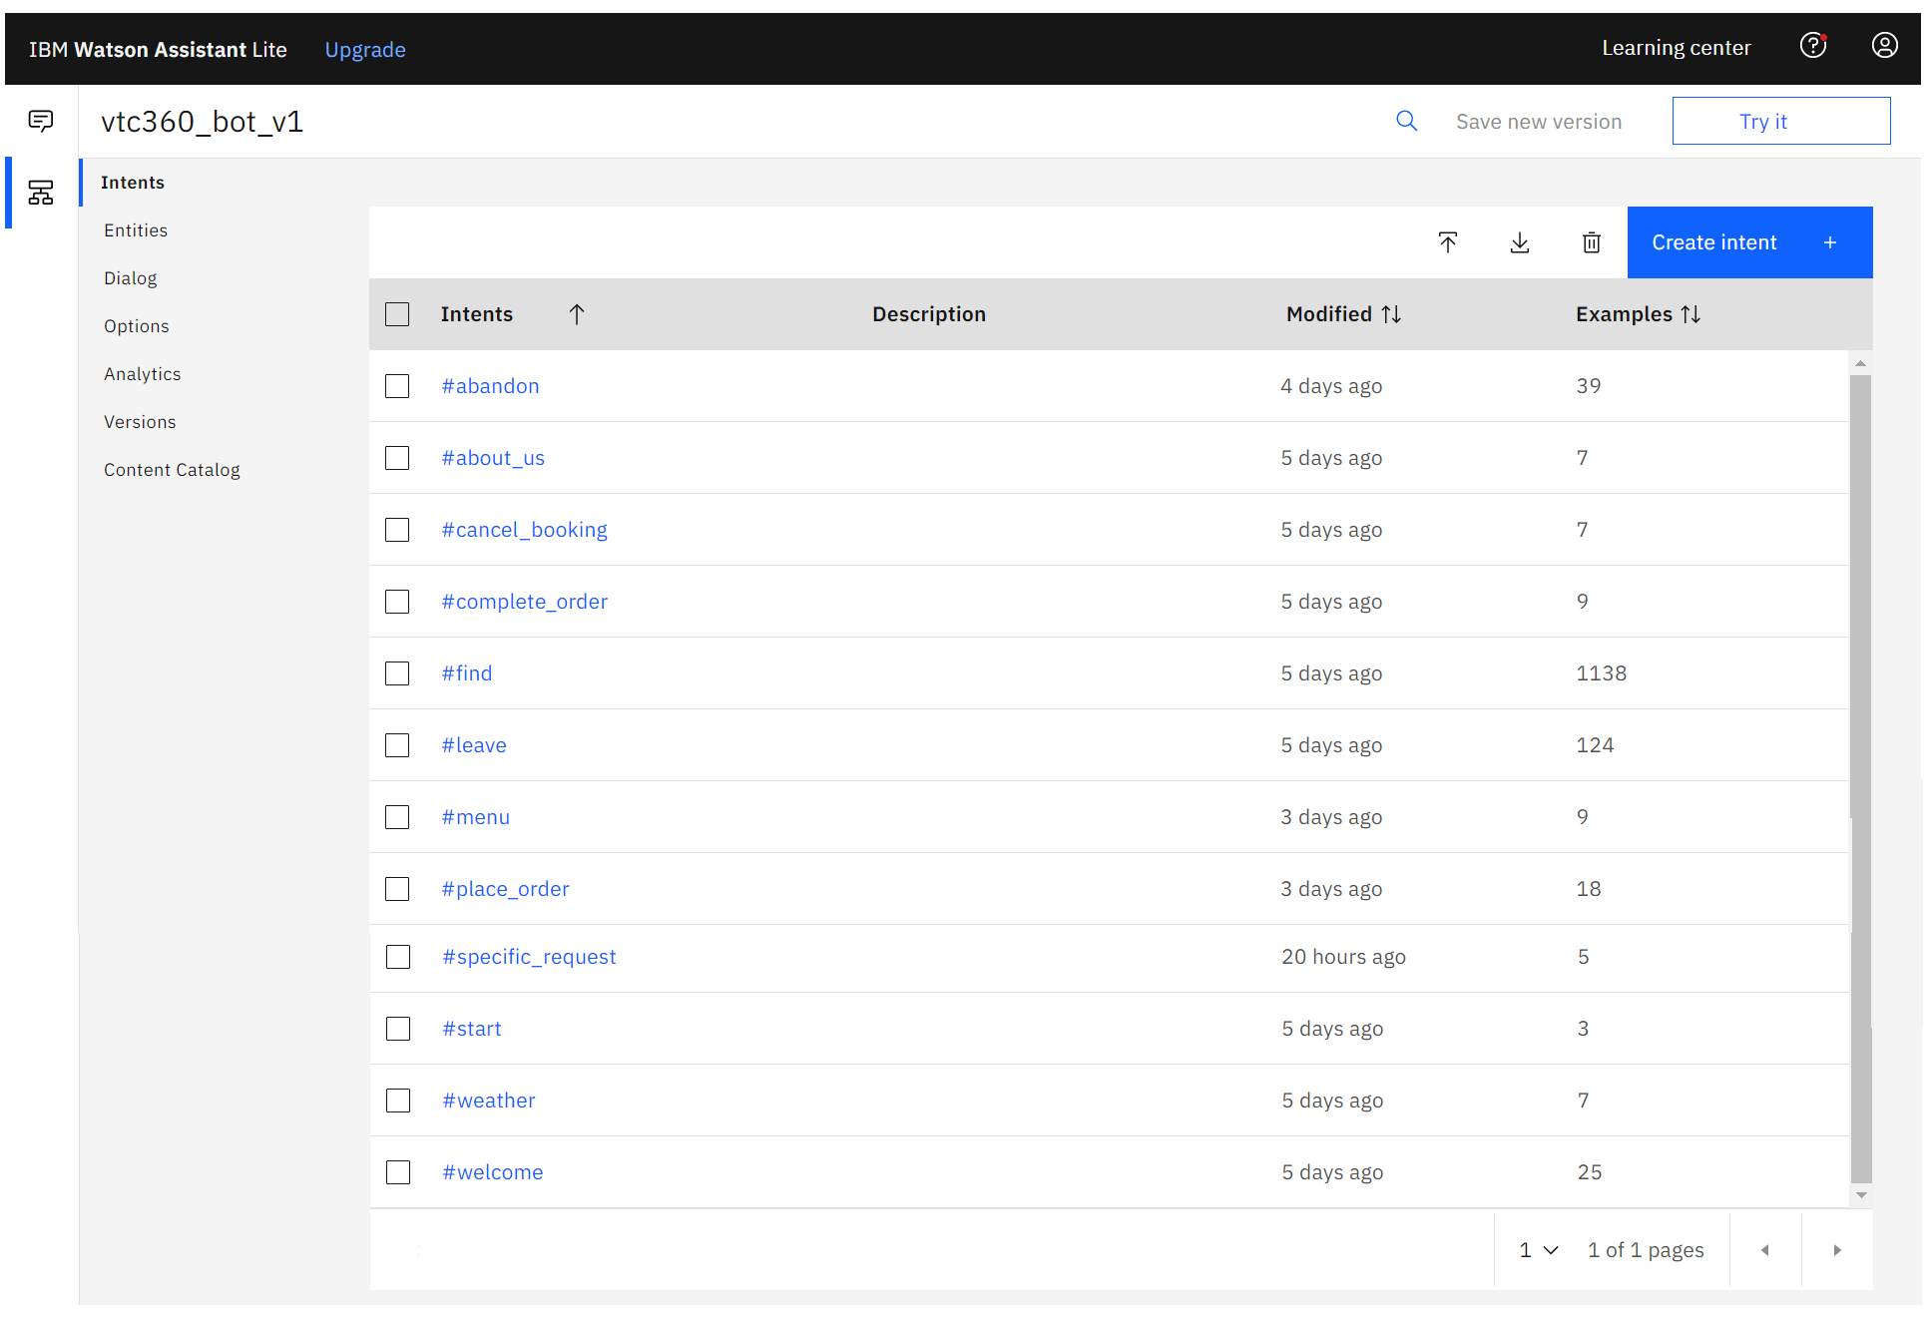
Intents

Slide 30
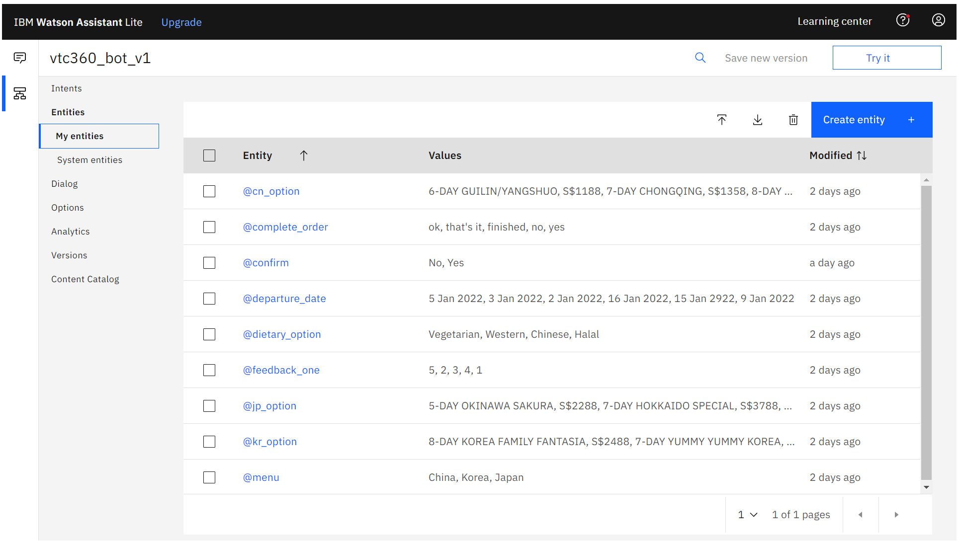
Entities

Slide 31
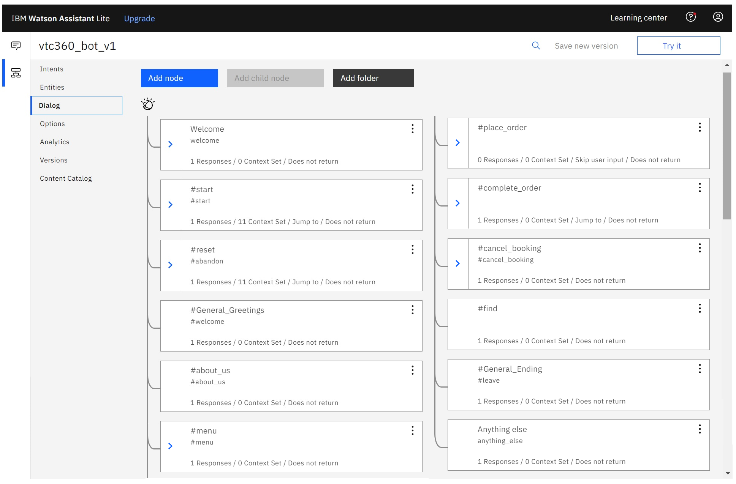
Dialog

Slide 32
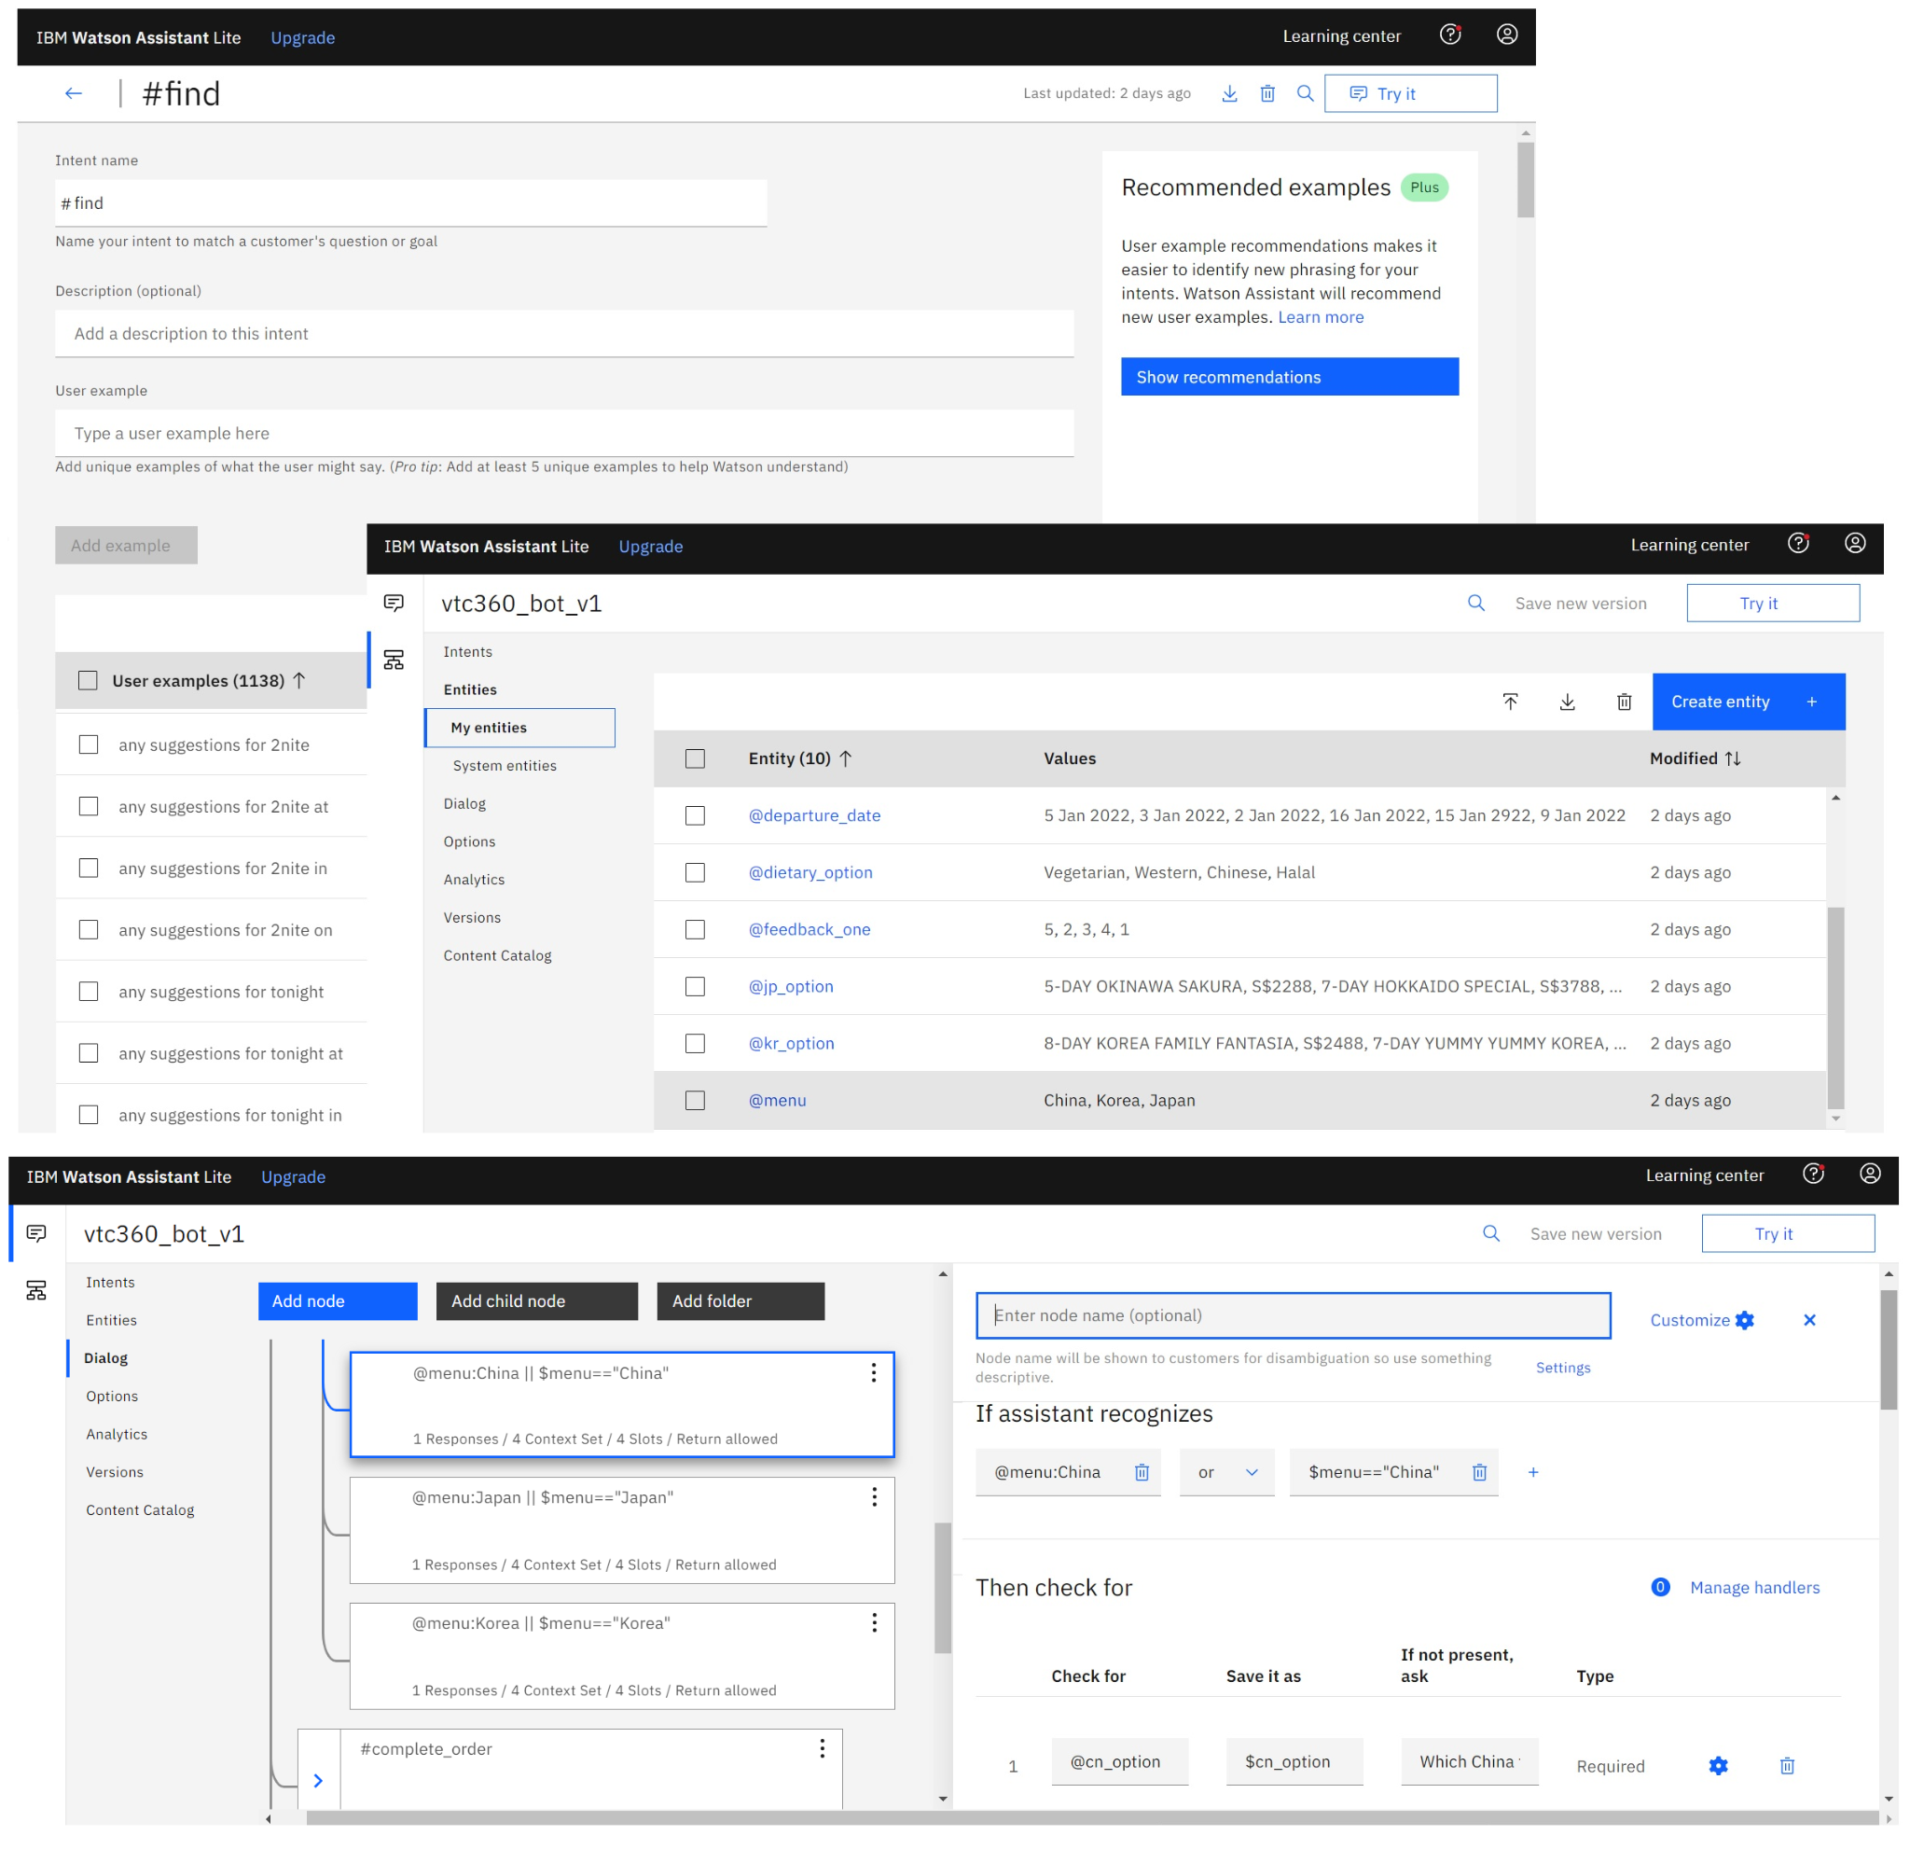
Example
User : Any suggestions for China package?
Intent : #find -> Any suggestions for
Entity : @menu -> China
Dialog :
Which China tour package would you like?
We have
→ 6-DAY GUILIN / YANGSHUO, S$1188
→ 7-DAY CHONGQING,S$1358
→ 8-DAY HUANGSHAN / JIANGNAN,S$1558
AI machine identifies the user's intent,
recognises the entity from the context
and then responds to the user accordingly
from the dialog.
Notes:
Must be clear that why we used which and what data set we used to train the chatbot.
The similar questions are asked here. Only the relevant data (unstructured data) is used for building the MVP.

Slide 33
4. Reasoning

Slide 34
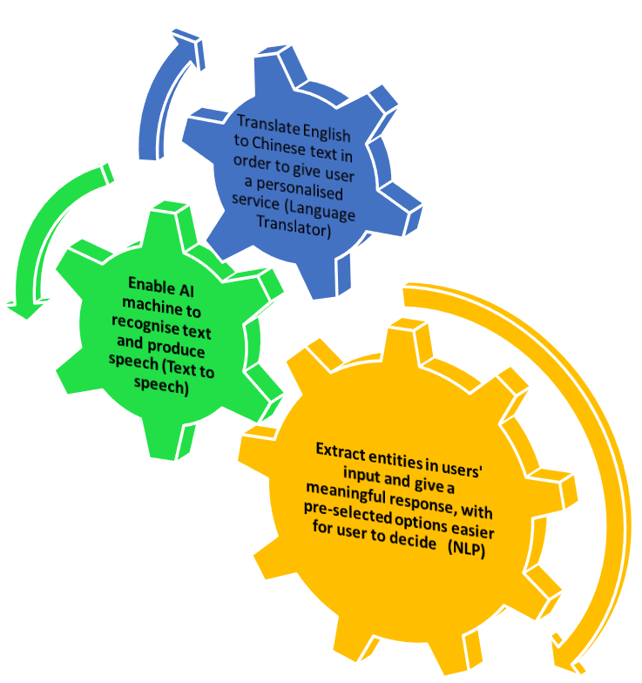
Reasoning
Notes:
The limitations are (compared with a human):-
1. Unable to understand human language and its infinite nuances and colloquial way of talking
2. Humans have world knowledge.
3. Awareness of self in relation to the environment.
4. Humans are better at decision making with little data or in rare circumstances.
5. Data from our senses, smell, taste, touch, hearing and intuition
6. We are the ultimate arbitrators of our own preferences
7. Privacy concerns restrict the data available to machines.
(why are we doing it this way?)
Doing one small task well (it is a machine it needs to be train
then I have to be discipline master to say what is ok what is not ok

Slide 35
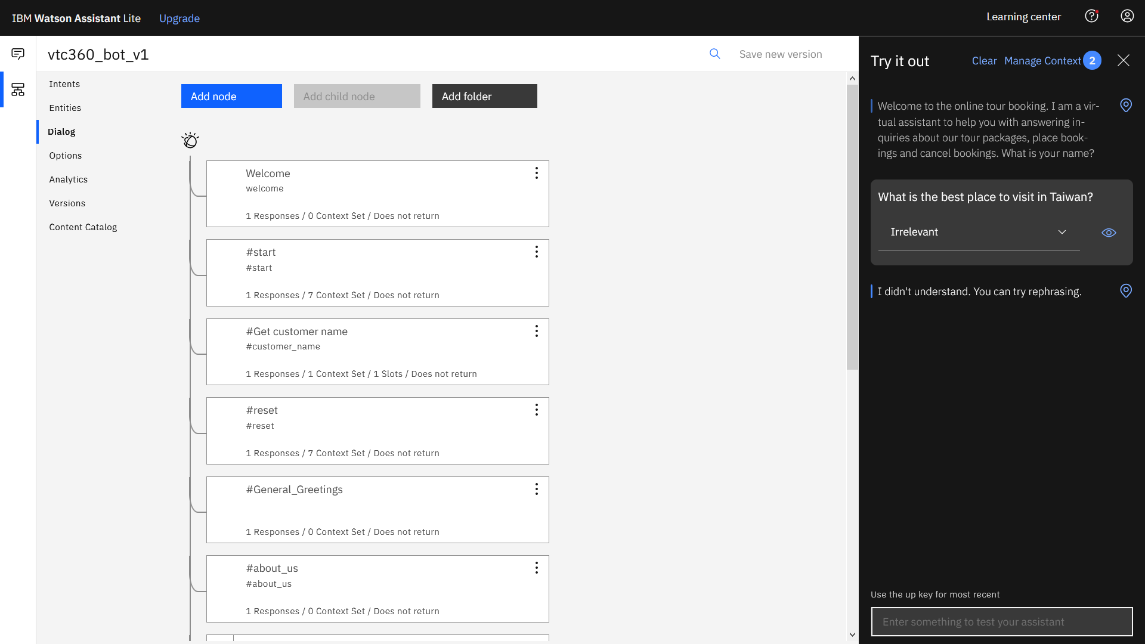
Training
Retag the untrained questions to the right dialog step for the chatbot to respond
Notes:
(Here) we need to show that one some dialog path doesn’t work
And how we can solve it with more data sets

Slide 36
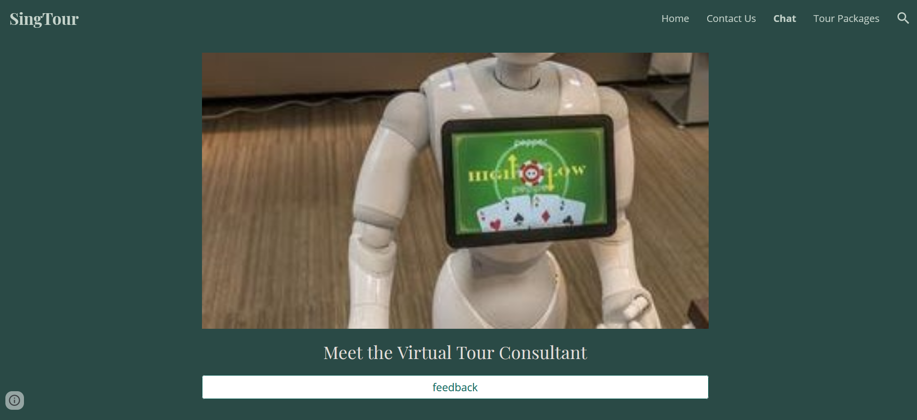

Chat

Slide 37
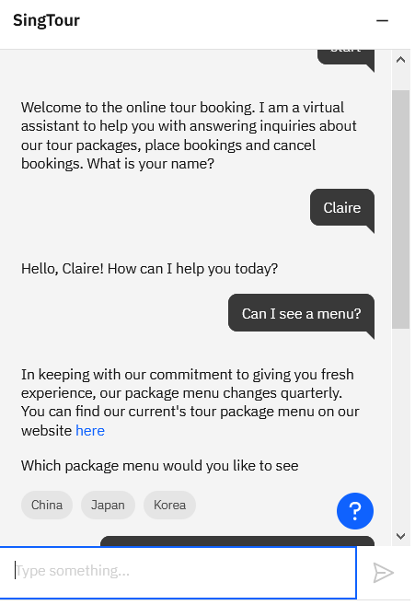
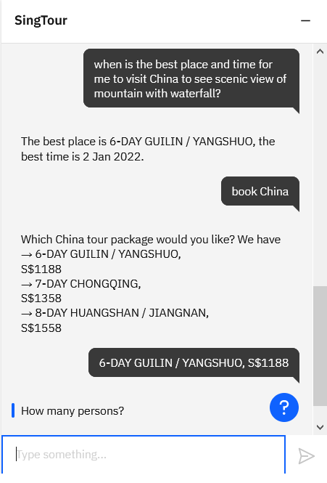
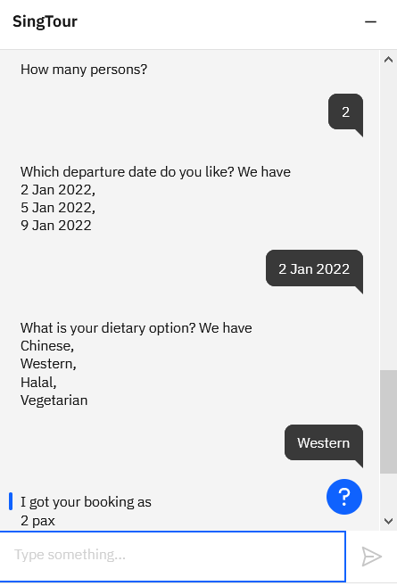
Booking
Notes:
We have to be clear about who is who lol
SingTour is the “who”...

Slide 38
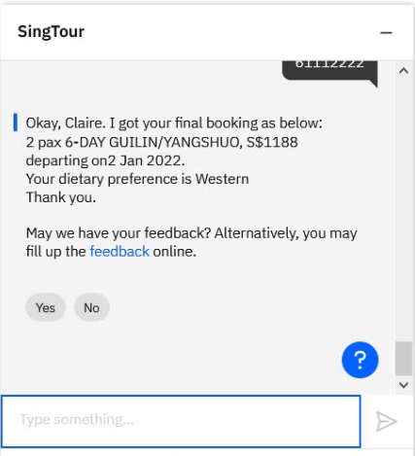
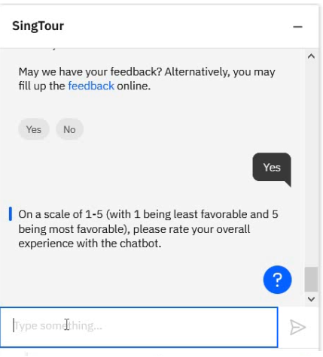
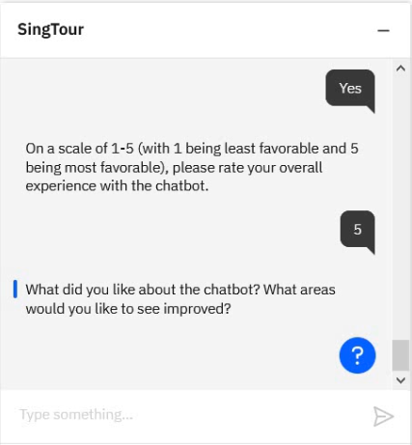
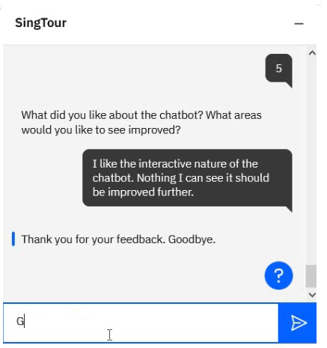
Feedback
Notes:
We have to be clear about who is who lol
SingTour is the “who”...

Slide 39
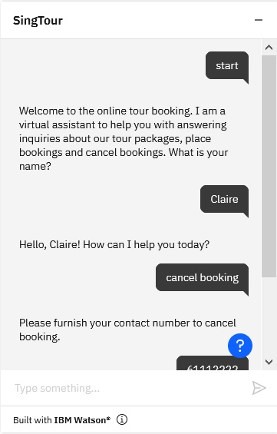
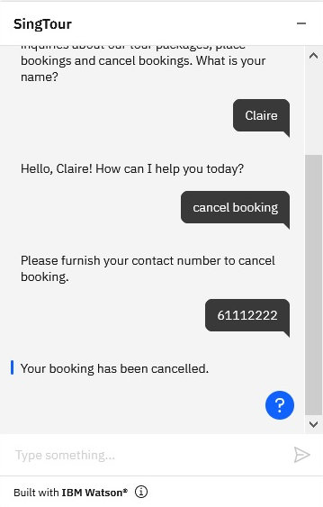
Cancelling
Notes:
We have to be clear about who is who lol
SingTour is the “who”...

Slide 40
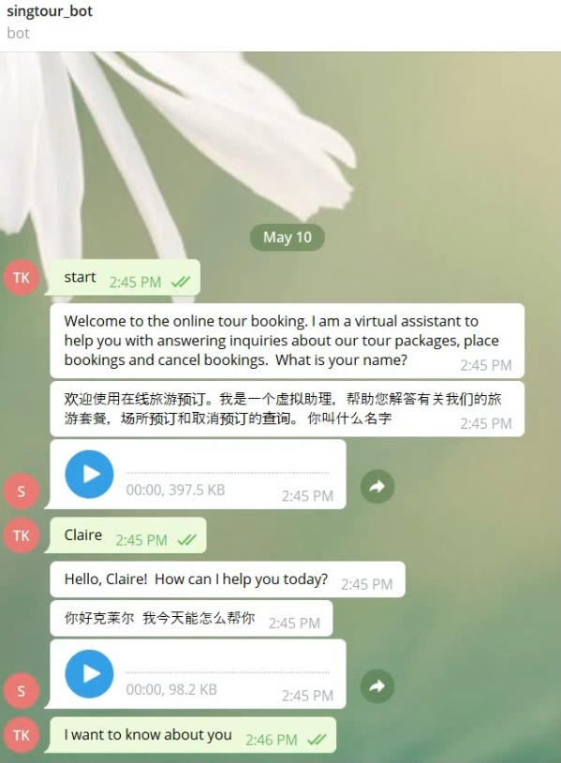
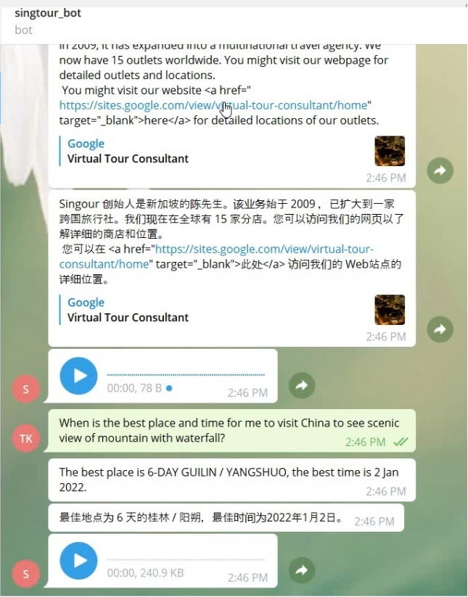
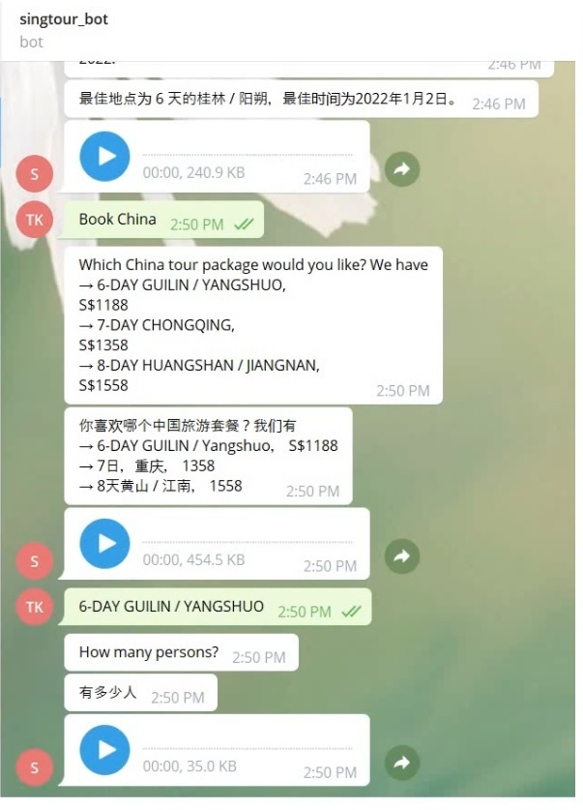
Deploying - Telegram with Mandarin Translation
Notes:
Kenneth: need to retake the screen, esp the agency name.

Slide 41
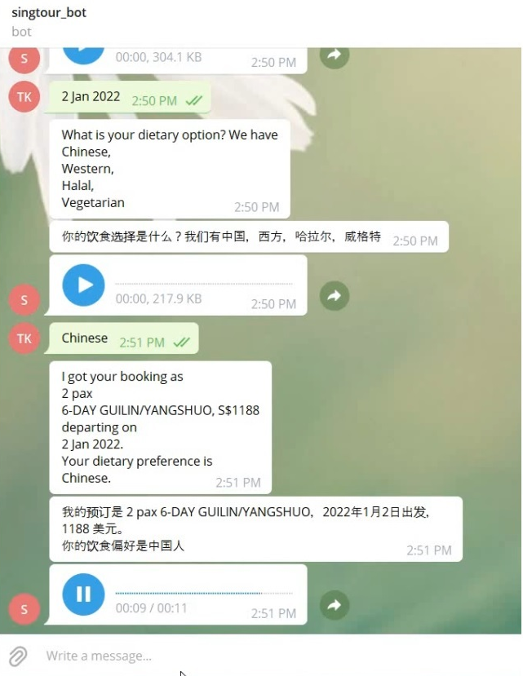
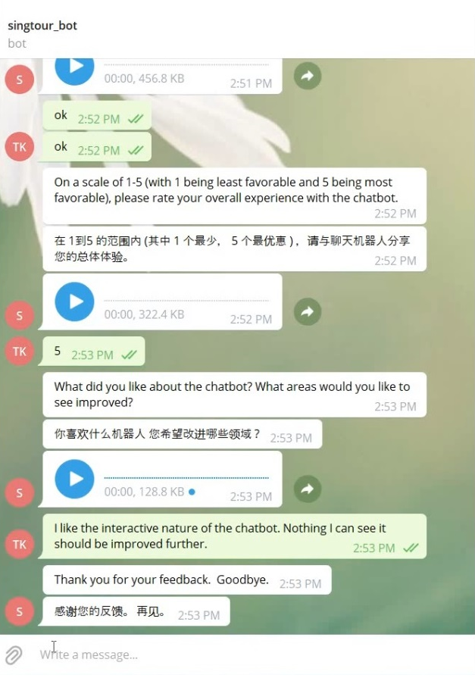
Deploying - Telegram with Mandarin Translation
Notes:
Kenneth: need to retake the screen, esp the agency name.

Slide 42
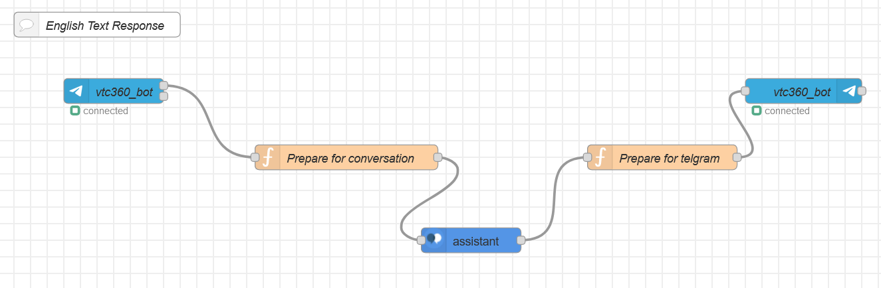
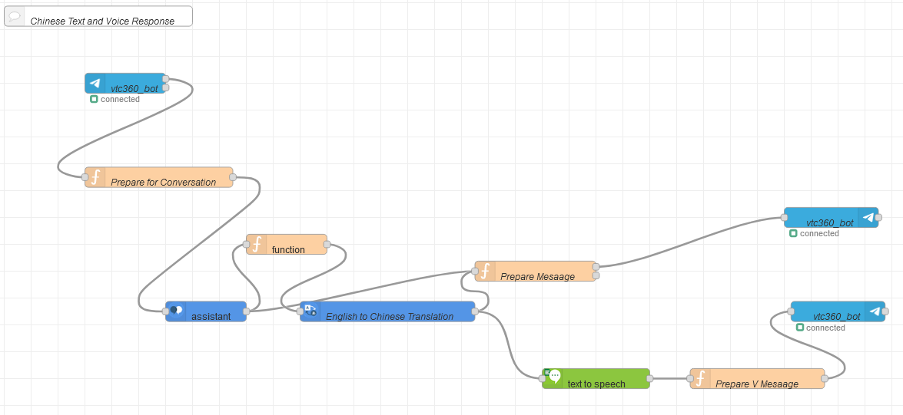
Node-red

Slide 43
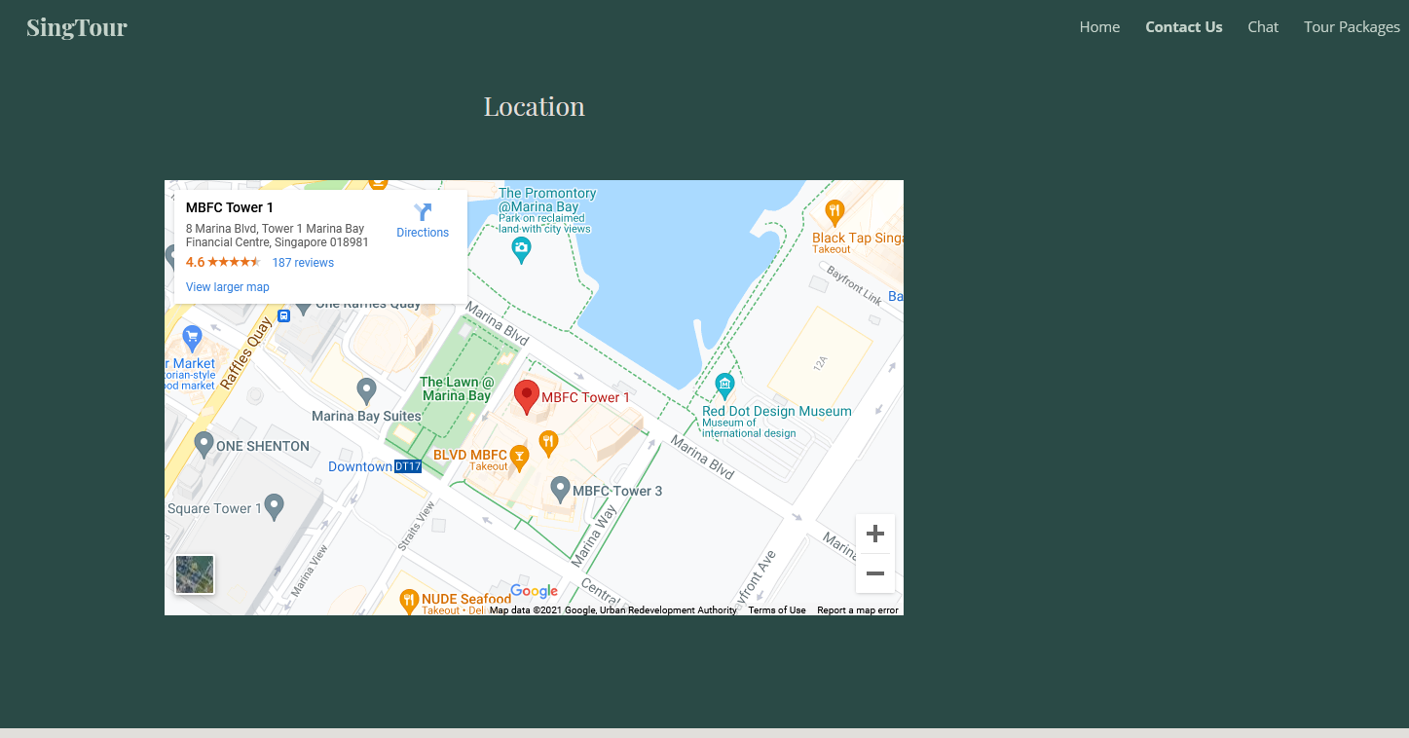
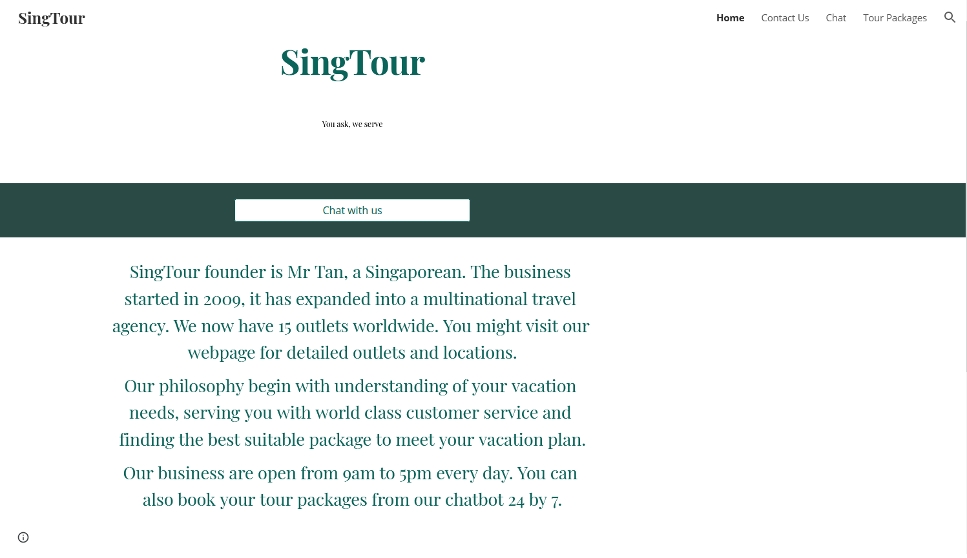
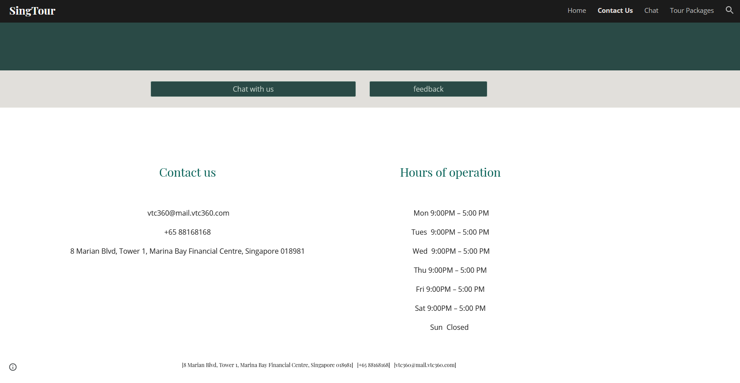
Home and Contact us details

Slide 44
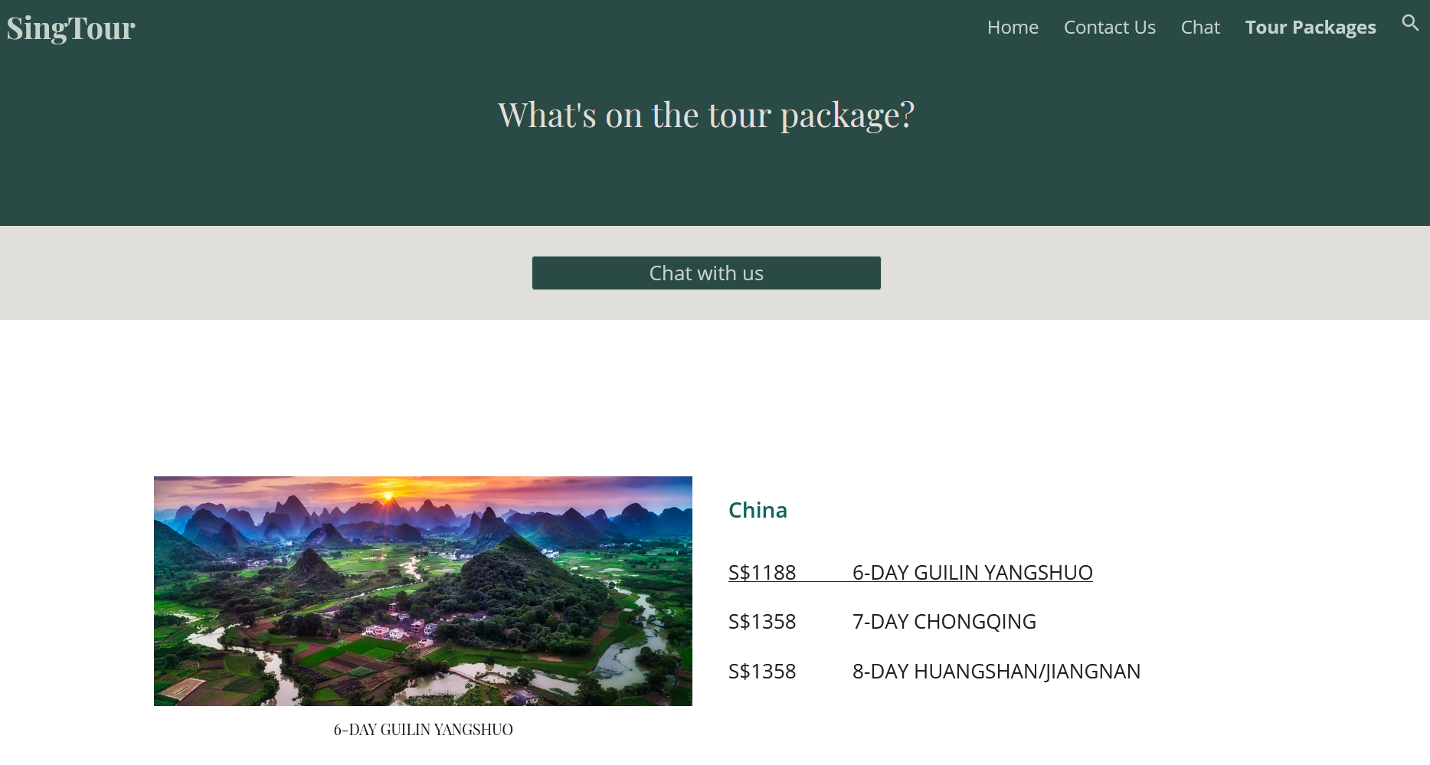
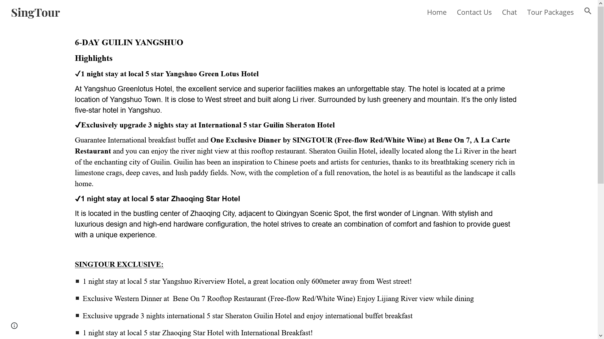
Tour package details
Notes:
Maybe just do 1 destination
Also webpage should feature chatbot
Score points dive deep to identify what AI cannot solve

Slide 45
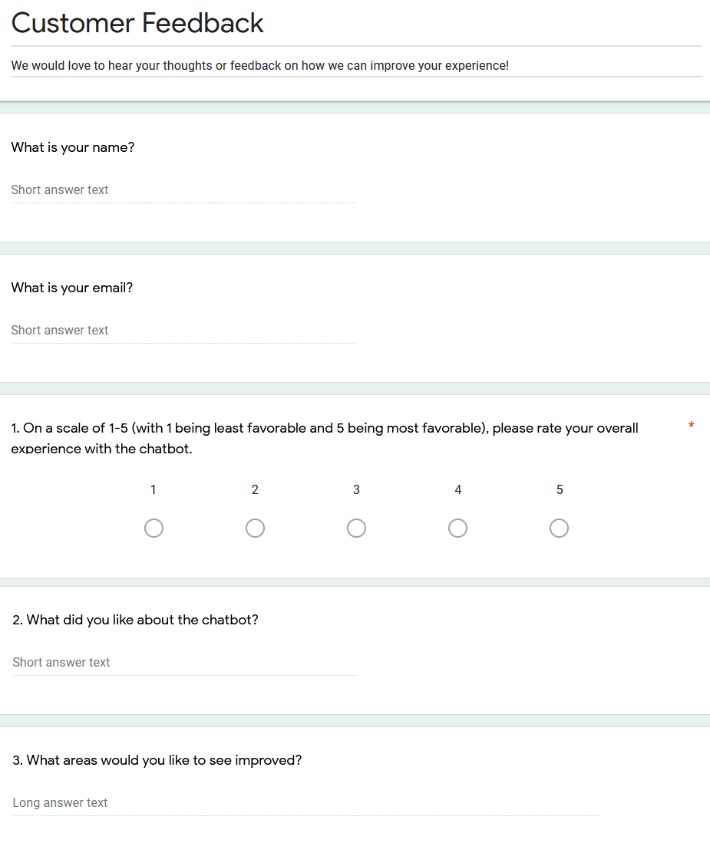
Feedback

Slide 46
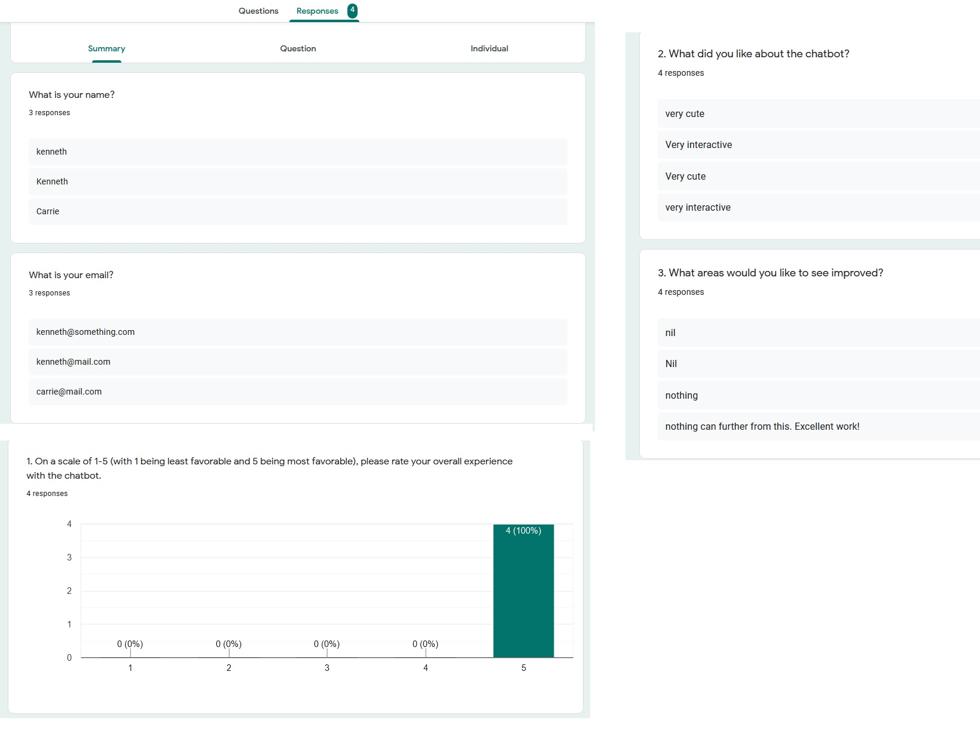
Feedback response

Slide 47
5. Knowledge
6. Expression

Slide 48
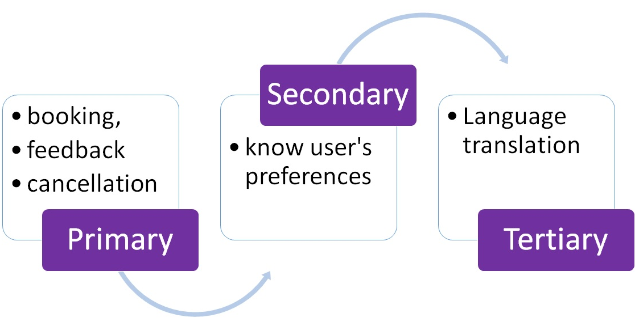
Knowledge
Reasoning Statement
SingTour can enrich customer interactions by offering personalised tour booking chatbot based on user info, user preferences and using NLP, Watson Assistant, Watson Translator and Text to Speech.
Notes:
Do up slides to show that the training that we did
Then what works and what doesn’t (what AI cannot do and how can we solve it)

Slide 49
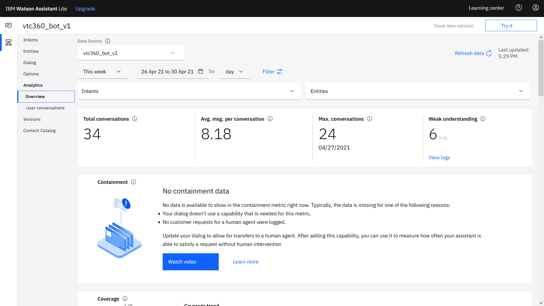
Web-traffic this week

Slide 50
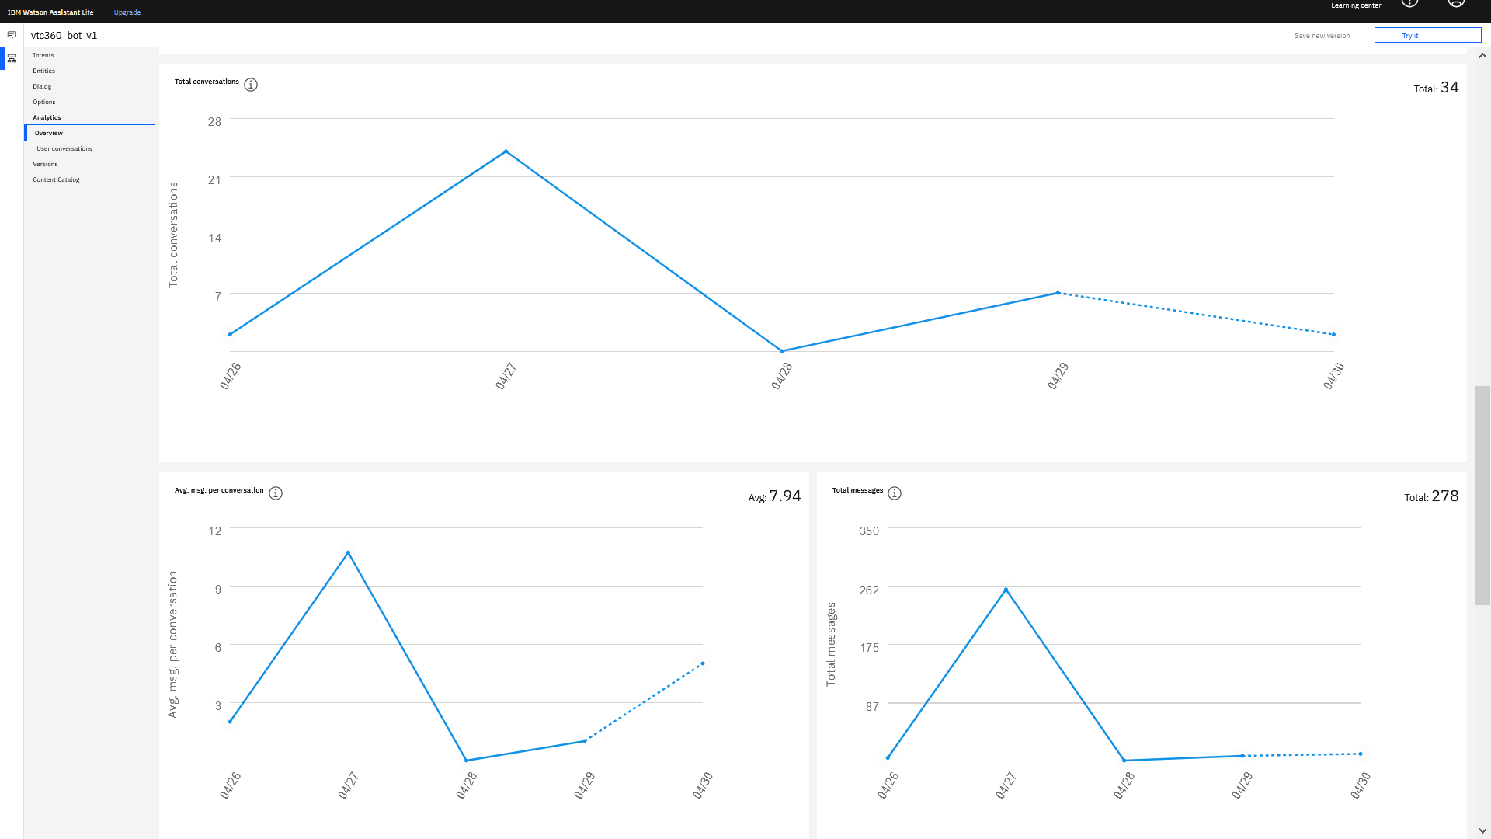
Trend on the web-traffic

Slide 51

User conversation - E.g. complete booking

Slide 52

User conversation - E.g. half-way through

Slide 53

User conversion - #cancel booking and irrelevant

Slide 54
7. User Reaction
8. Learning

Slide 55

Positive Feedback
Provide 24/7 customer support and bookings of travel packages
Provide more information to the customer by directing to our website
Recommendations from chatbot
Mandarin translation for better communication
Notes:
Recap aspects that AI can and cannot solve

Slide 56

Negative Feedback
Unable to handle complex queries from customers
Lack of human touch/ emotions
Security concerns by giving out sensitive information in chatbot (AI ethics)

Slide 57

Further Improvements
Continuous improvements
Enhance security features
Ability to understand emotions by tone analyzer
Speech-to-text
More language translations
Human intervention

Slide 58
9. Reflection

Slide 59
Challenges faced by team in this project
Indefinite nuances and colloquial way of talking/ expressing
Hotlinking of images under common creative license
Watson assistance not responding sometimes
Relevant Tour and Tourism datasets are scarce
Time consuming to transform data to fit SIngTour’s business model
Develop first MVP due to limited time and resources
Notes:
This section should be more about what challenges the team faced in each of the prior sections

Slide 60

We welcome your feedback!

